Slide 1
Deep Neural Network Compression and Speedup
周争光
2017-7-10

Slide 2
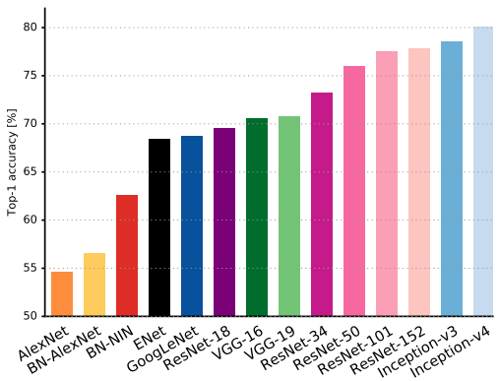
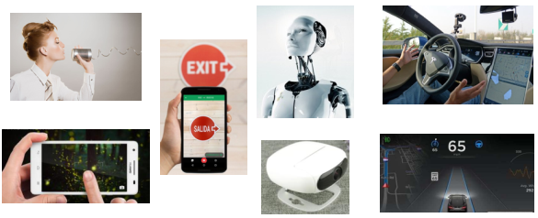
Intelligent & Applications
Canziani, A., Paszke, A., & Culurciello, E. (2016). An analysis of deep neural network models for practical applications. arXiv preprint arXiv:1605.07678.

Slide 3
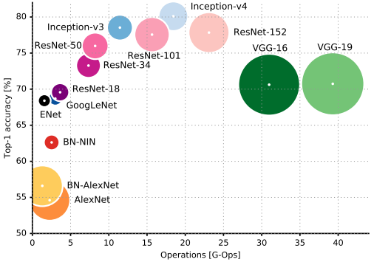
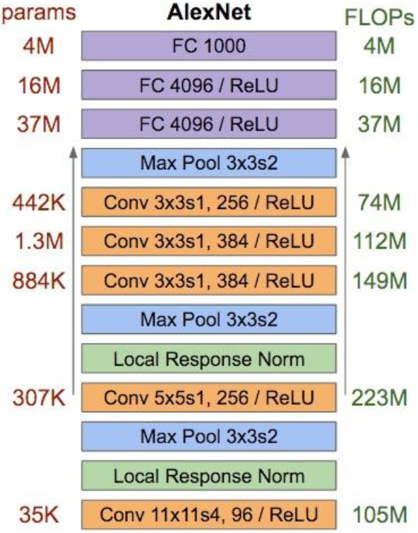
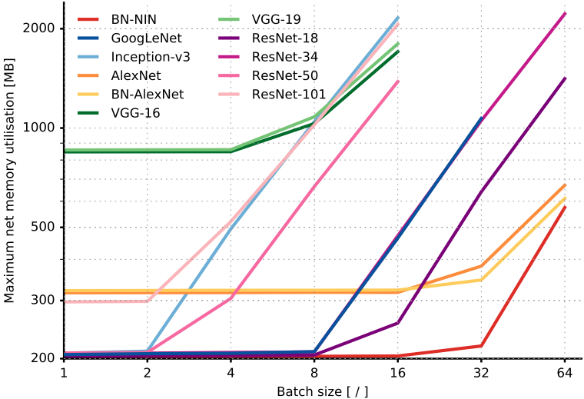
Deep models!

Slide 4
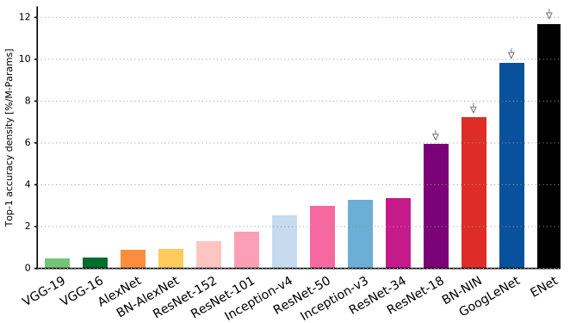
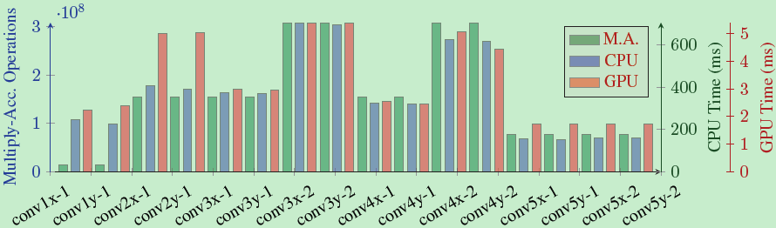
Why smaller models?
Oversized
Correlated
Yani Ioannou, Duncan Robertson, Jamie Shotton, Roberto Cipolla, and Antonio Criminisi. Training cnns with low-rank filters for efficient image classification. arXiv preprint arXiv:1511.06744, 2015.

Slide 5
Teacher-Student Model
Network Pruning
Network Quantization
Decomposition & Factorization
Sparsity
Design
Outline

Slide 6
Teacher-Student Model
  Distillation
Network Pruning
Network Quantization
Decomposition & Factorization
Sparsity
Design
Outline

Slide 7


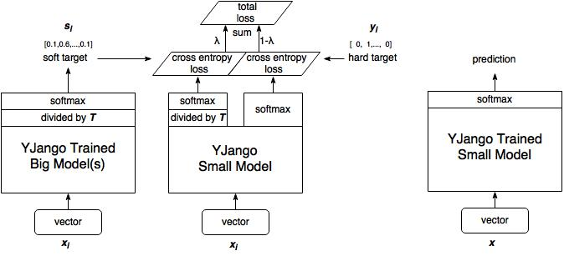
1. Teacher-Student Model
Distillation:
Geoffrey Hinton, Oriol Vinyals, and Jeff Dean. Distilling the knowledge in a neural network. arXiv preprint arXiv:1503.02531, 2015.

Slide 8
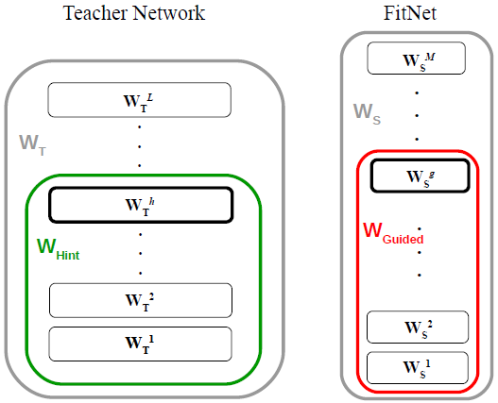
1. Teacher-Student Model
Further reading
  Do Deep Convolutional Nets Really Need to be Deep and Convolutional? – Yes, they do.
  FitNets:
  Higher hidden layer
Ping Luo, Zhenyao Zhu, Ziwei Liu, Xiaogang Wang, Xiaoou Tang, et al.Face model compression by distilling knowledge from neurons. In AAAI, pages 3560–3566, 2016.

Slide 9
Teacher-Student Model
Network Pruning
  Prune filters
Network Quantization
Decomposition & Factorization
Sparsity
Design
Outline

Slide 10
2. Network Pruning
An Entropy-based Pruning Method
  1. off-the-shelf CNN models
  2. Evaluate each filter’s importance by entropy-based method and discard it(reduce the corresponding intermediate activations)
  3. Fine-tuning the smaller model
  VGG-16: 3.3×speedup and 16.64×compression
  ResNet-50: 1.54×speedup and 1.47×compression
  Both decrease about 1% top-5 accuracy
Jian-Hao Luo and Jianxin Wu. An entropy-based pruning method for cnn compression. arXiv preprint arXiv:1706.05791, 2017.

Slide 11
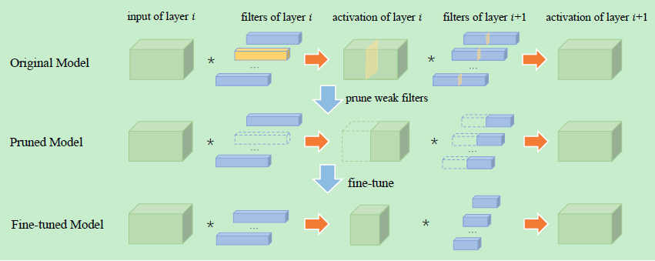
An Entropy-based Pruning Method
GAP: c*h*w—1*c—n*c (n: 10 images)
m bins, compute p & H, keep top k filters
prune->1~2epochs recover, final->many epochs

Slide 12
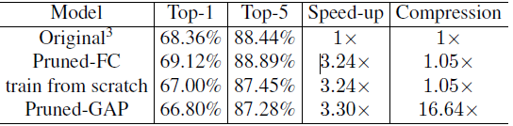
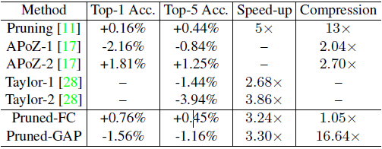
An Entropy-based Pruning Method
VGG-16 (first 10 layers: 90% FLOPs)
  Prune conv layers, fc layers replaced by GAP
  1-2 epochs and 12 epochs for conv4-3
  Prune each layer with 50% CR, ->3.3 speedup

Slide 13
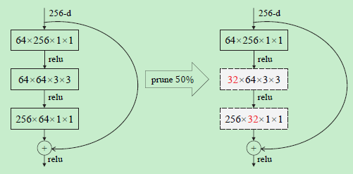
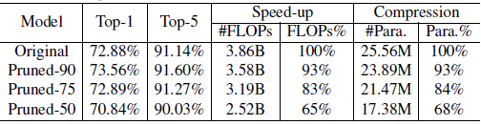
An Entropy-based Pruning Method
ResNet-50 (param located in the last 2 layers)
  Output channel needs to be consistent
  Prune the intermediate layer in each block

Slide 14
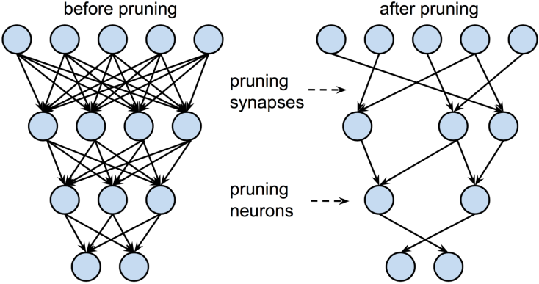
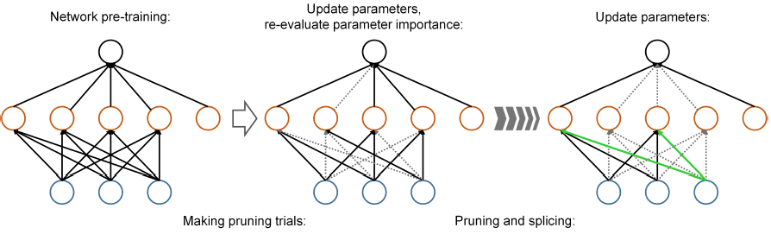
2. Network Pruning
Further reading
  Prune connections
  Prune filters (L1-norm)
  Dynamic Network Surgery

Slide 15
Teacher-Student Model
Network Pruning
Network Quantization
  INQ
Decomposition & Factorization
Sparsity
Design
Outline

Slide 16
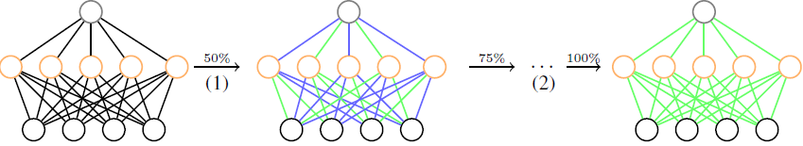
3. Network Quantization
Incremental network quantization
  Towards lossless CNNs with low-precision weights
  Weight partition, group-wise Q and re-training
  Iterative manner until all weights are low-precision
  Pre-trained model, Weight-> 0 or power of two
  Not global Q, one group->low-precision, the other to recover the loss
Aojun Zhou, Anbang Yao, Yiwen Guo, Lin Xu, and Yurong Chen. Incremental network quantization: Towards lossless cnns with low-precision weights. arXiv preprint arXiv:1702.03044, 2017.

Slide 17


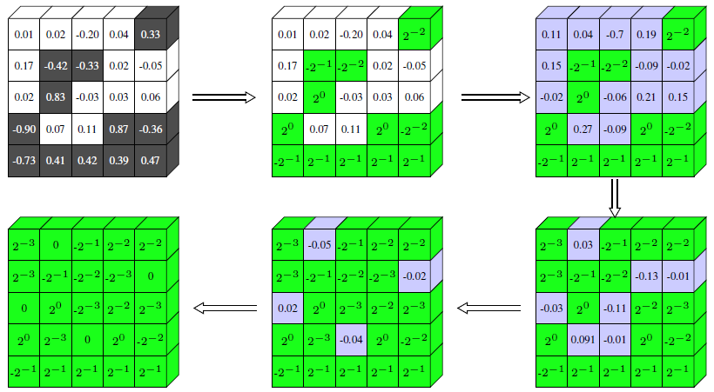
Incremental network quantization
Weight quantization with variable-length encoding
  Set b

Slide 18
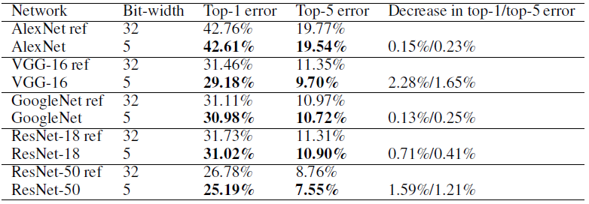

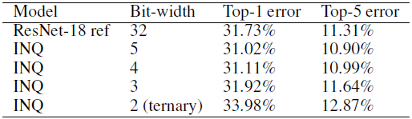
Incremental network quantization
5 bit: 1bit for 0, 4 bits for 16 different values
Partition strategies: random or inspired
Low-precision for ResNet-18 model

Slide 19
3. Network Quantization
Further reading
  BinaryConnect, Binarized-NN, Xnor-net
  TWN(Ternary weight networks, -w, 0, +w)
  Vector quantization
  HashNet, LSH-NN, FunHashNN, FreshNets
  Weight sharing
  ECSQ
  HWGQ-Net

Slide 20
Teacher-Student Model
Network Pruning
Network Quantization
Decomposition & Factorization
  Factorized CNN
  Tucker decomposition
Sparsity
Design
Outline

Slide 21
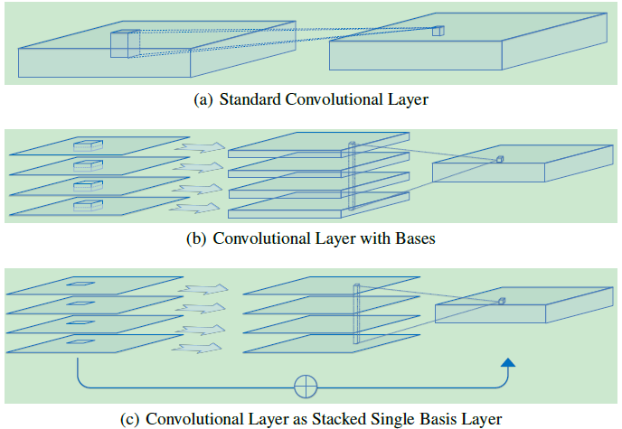
4. Decomposition & Factorization
Factorized Convolutional Neural Networks
  3D conv ->single in-channel spatial convolution and linear channel projection

Slide 22





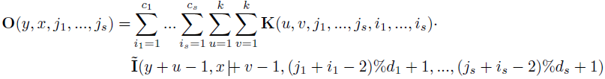
Factorized Convolutional Neural Networks
Standard conv:
Conv with bases:
Conv with single basis:
Topological Connections: ->linear projection(k=1)
Min Wang, Baoyuan Liu, and Hassan Foroosh. Factorized convolutional neural networks. arXiv preprint arXiv:1608.04337, 2016.

Slide 23
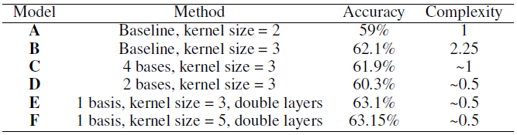
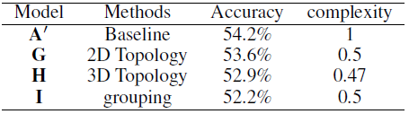
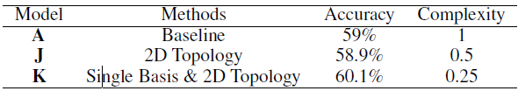
Factorized Convolutional Neural Networks
  Conv with bases
  Topological Connections
  Combine single and TC (3×faster than GoogLeNet)

Slide 24
Teacher-Student Model
Network Pruning
Network Quantization
Decomposition & Factorization
  Factorized CNN
  Tucker decomposition
Sparsity
Design
Outline

Slide 25
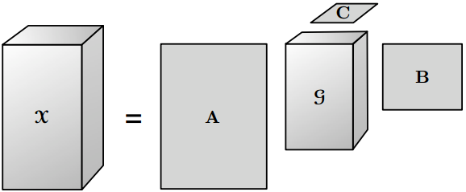
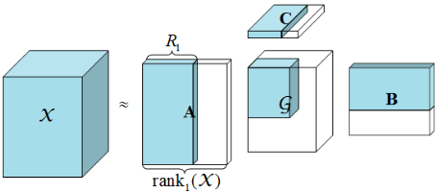
4. Decomposition & Factorization
  Tucker decomposition
  Compress deep CNN
    Rank selection->global analytic VBMF
    Tucker decomposition on kernel tensor
    Fine-tuning to recover accumulated loss of accuracy
    AlexNet: 5.46×c,2.67×s; VGG-S: 7.40×c,4.80×s;
    GoogLeNet: 1.28×c,2.06×s; VGG-16: 1.09×c,4.93×s;
Yong-Deok Kim, Eunhyeok Park, Sungjoo Yoo, Taelim Choi, Lu Yang, and Dongjun Shin. Compression of deep convolutional neural networks for fast and low power mobile applications. arXiv preprint arXiv:1511.06530, 2015.

Slide 26


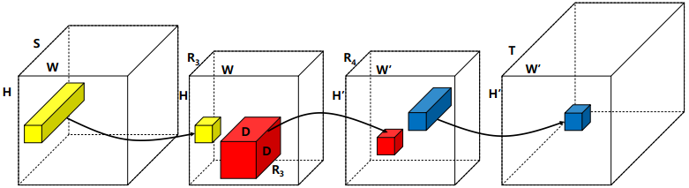
  Tucker decomposition
Tucker decomposition
Tucker-2 decomposition
Three convolution:
Yellow tube, red box, and blue tube: 1×1，D×D，1×1 conv

Slide 27
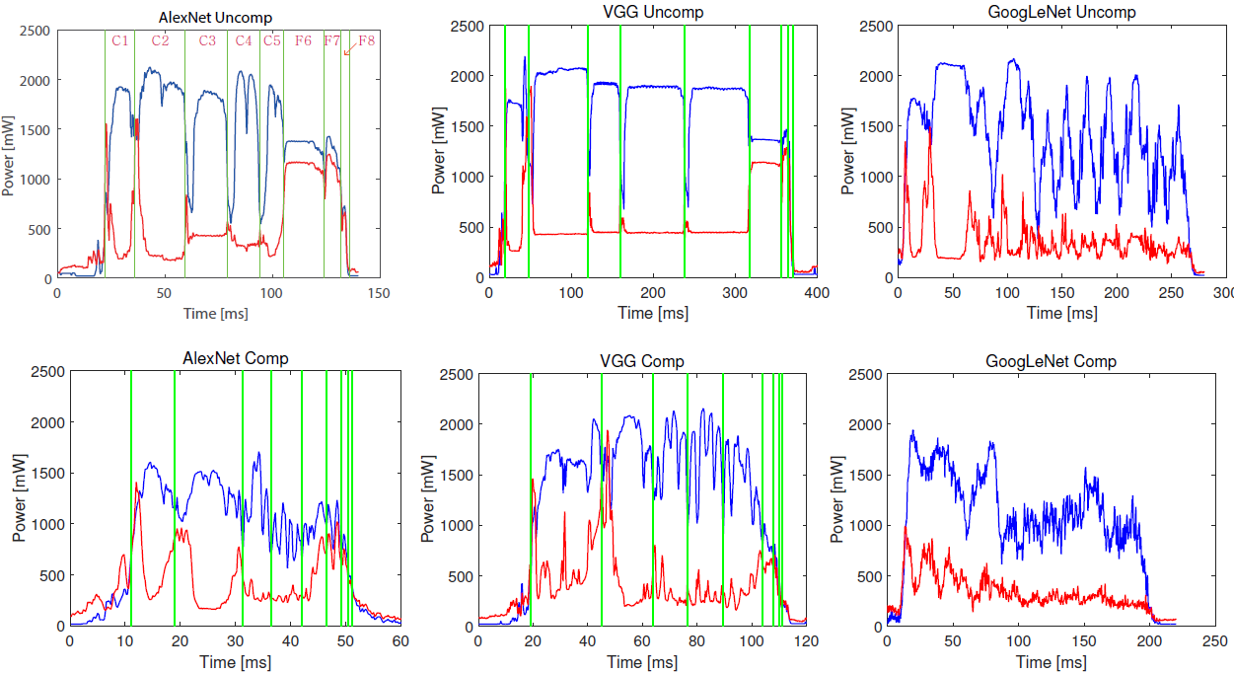
  Tucker decomposition
Complexity analysis
Power consumption (Blue:GPU,Red: memory)

Slide 28
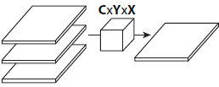
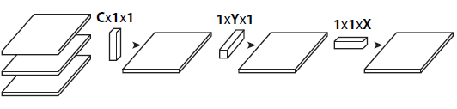
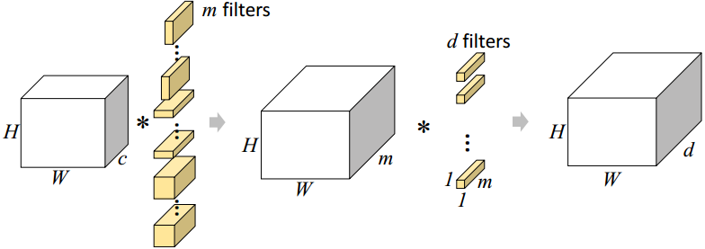
4. Decomposition & Factorization
Further reading
  MobileNets
  Flattened CNN
  SVD
  CPD (canonical polyadic decomposition)
  BTD (block tensor decomposition)
  Circulant projections
  Train low rank filters

Slide 29
Teacher-Student Model
Network Pruning
Network Quantization
Decomposition & Factorization
Sparsity
  PerforatedCNNs
Design
Outline

Slide 30
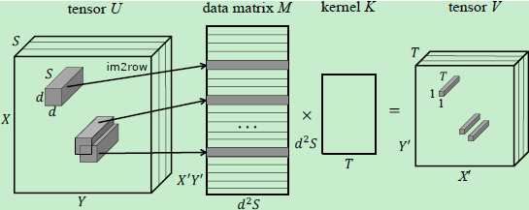
5. Sparsity
  PerforatedCNNs
    Inspired by the loop perforation technique
    Leave only a subset of rows(defined by a perforation mask) in the data matrix M and to interpolate the missing output values
Mikhail Figurnov, Aizhan Ibraimova, Dmitry P Vetrov, and Pushmeet Kohli. Perforatedcnns: Acceleration through elimination of redundant convolutions. In Advances in Neural Information Processing Systems, pages 947–955, 2016.

Slide 31
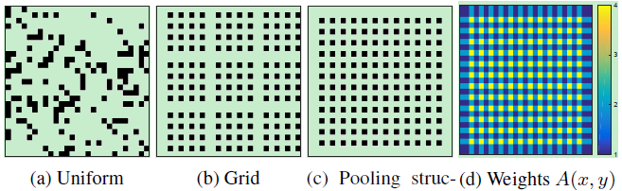
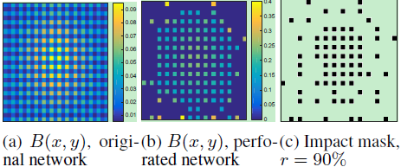
PerforatedCNNs
Define the perforation mask I, get index of the nearest neighbor
Only need to calculate V for I, other positions are interpolated
Perforation masks
  Uniform, Grid, Pooling structure, Impact

Slide 32
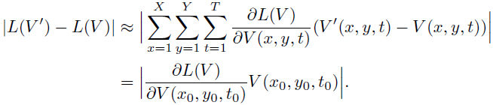
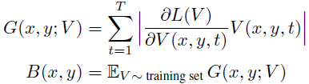
PerforatedCNNs
Impact
  Estimate the impact of each position on loss function
  Total impact, keep the top-N positions—highest B
  Iterate between increasing the perforation rate of a layer and recalculation of impacts, employ a simple greedy strategy to find a combination of per-layer perforation

Slide 33
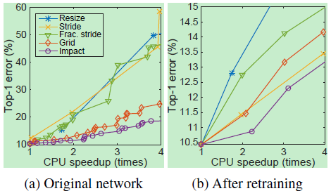
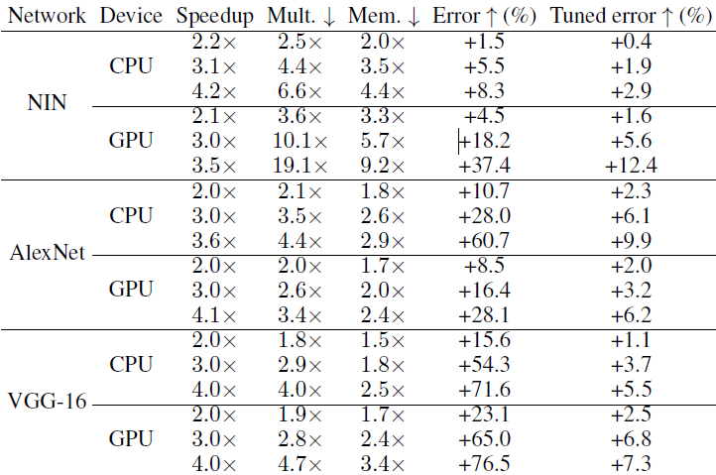
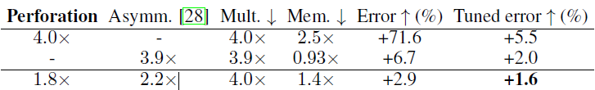
PerforatedCNNs
Baseline methods: Resize, Stride, Fractional stride, Grid, Impact
Whole network results:
Combining acceleration methods

Slide 34
5. Sparsity
Further reading
  Sparse convolutional neural networks
  StochasticNet
  Less is more
  More is less
    Feature maps after ReLU are usually sparse, many 0
    Skip calculating the zero cells and only compute the values of non-zero cells in each response map

Slide 35
Teacher-Student Model
Network Pruning
Network Quantization
Decomposition & Factorization
Sparsity
Design
  LCNN
Outline

Slide 36
6. Design
LCNN: Look-up based conv nn
  Leverage the correlation between the parameters and represent the space of param by a compact set of weight vectors, called dictionary
  Training LCNN involves jointly learning a dictionary and a small set of linear combinations
  Can deal with few-shot and few-iteration learning
Hessam Bagherinezhad, Mohammad Rastegari, and Ali Farhadi. Lcnn: Lookup-based convolutional neural network. arXiv preprint arXiv:1611.06473, 2016.

Slide 37

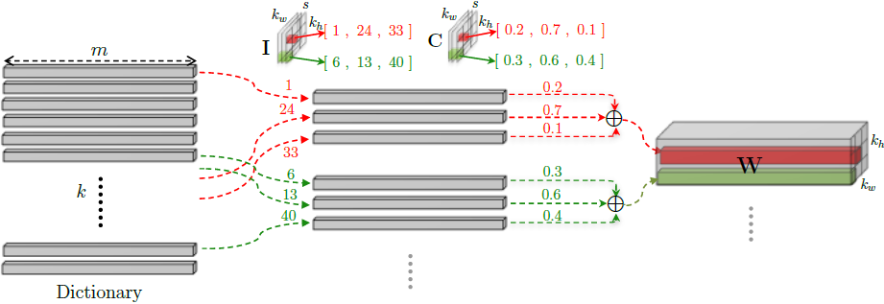
LCNN
Replace the W:
  Store D,I and C instead of the weight tensors W
  Hyper-parameter: k and s

Slide 38

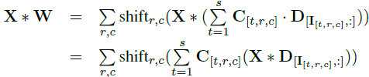


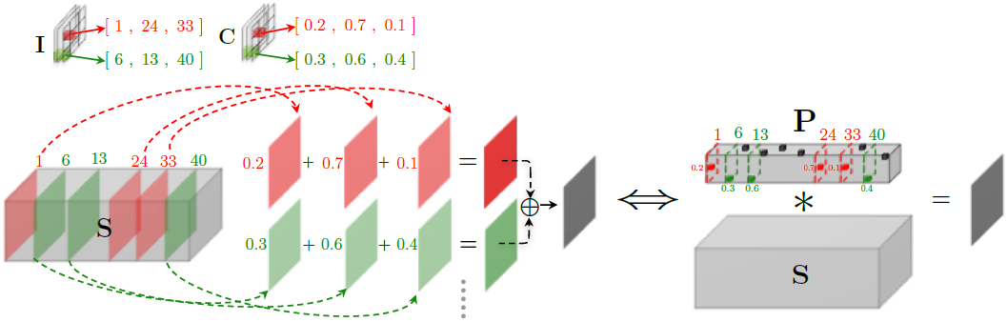
LCNN
Fast conv using a shared dictionary:
  A conv-> a sum of 1×1 conv:

Slide 39


LCNN
Training LCNN:
  P is s-sparse
  Relax P to l1-norm, keep top-s entries
  FC is a special conv

Slide 40
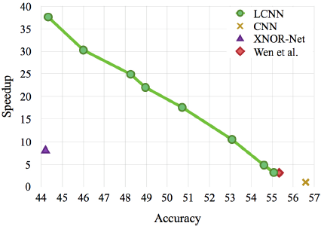
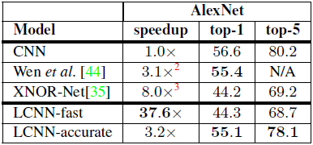
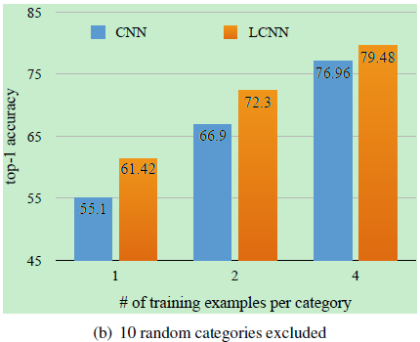
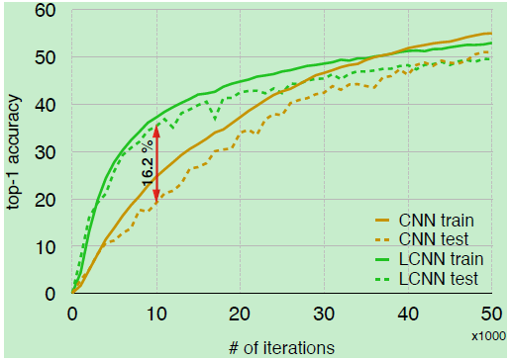
LCNN
Image classification
Few-shot learning, Few-iteration learning

Slide 41
6. Design
Further reading
  SqueezeNet: AlexNet-level with 50×compression
  LBCNN: local binary convolutional neural network
  Deep SimNets
  ShuffleNet
  Hardware design:
    EIE
    ZNN
    FINN

Slide 42
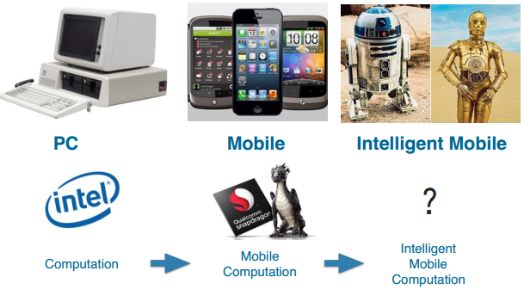
Thank you!

Slide 43
Appendix: website
1. https://github.com/ljk628/ML-Systems/blob/master/dl_cnn.md
2. https://handong1587.github.io/deep_learning/2015/10/09/acceleration-model-compression.html
3. https://github.com/handong1587/handong1587.github.io/blob/master/_posts/deep_learning/2015-10-09-acceleration-model-compression.md
4. https://github.com/andyhahaha/Convolutional-Neural-Network-Compression-Survey
164. https://www.zotero.org/zhgzh164/items/collectionKey/NNPBUACA
164. https://github.com/zhouzhengguang/Read_CS

